Slide 1
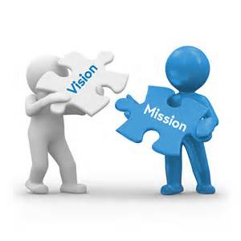


Strategic Planning
Orientation

Slide 2

Welcome
Superintendent Dr. Melissa Kaczkowski
Who are we and what are we here to do?
Introduction of Plan Team members
Review of Meeting Dates and Times
Introduction of Facilitator

Slide 3

The foundation of CONTINUOUS IMPROVEMENT rests upon the pillars of mission, vision, and goals. Each of these pillars asks a different question of stakeholders within the system. The pillars rest on Core Values.

Slide 4

FOUNDATION OF CONTINUOUS IMPROVEMENT
Pillars | Guiding Question
MISSION | What is our fundamental purpose; why do we exist?
VISION | What must we become in order to accomplish our fundamental purpose?
GOALS | How will we know if we are making a difference?
VALUES | How must we behave to achieve our mission, vision and goals?

Slide 5

Strategic Planning Process
Where do we want to be?
Where are we now?
How will we get to where we want to be?
What
are we learning?
Vision and
Mission
Needs
Assessment
Goal Setting
Action
Planning
Monitor
Adjust
Improve
Stakeholder Input/ Impacts
Defining Key Areas To Improve
Gap Analysis
SMART Goals
Strategies
Best Practice
Staff Development
Adjust
Structures &Processes
Review and Revise
Implement
Strategies
Implement
Strategies
Annual- Formative
Multi-Year: Summative

Slide 6

It is good to have an end to journey toward;
but it is the journey that matters in the end.
Ursula K. LeGuin 1999
WHERE DO WE WANT
TO BE?
HOW DO WE GET FROM
WHERE WE ARE TO
WHERE WE WANT TO BE?
WHERE ARE WE NOW?
CONTINUOUS IMPROVEMENT

Slide 7
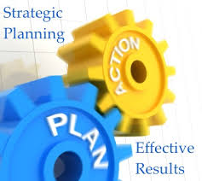
“The size and the prettiness of the plan is inversely related to the quality of action and the impact on student learning.”
- Doug Reeves

Slide 8

“See it big, and keep it simple.”
~Wilfred Peterson

Slide 9
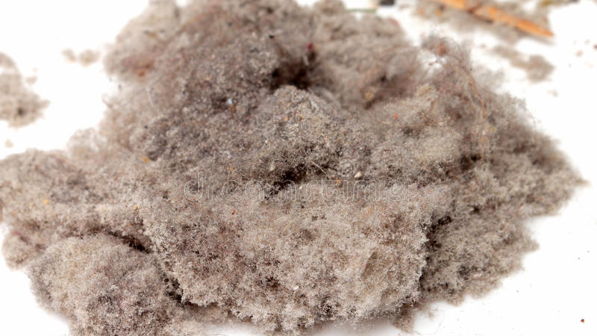
Keep it alive-
not sitting on the shelf
collecting dust

Slide 10

Strategic Plans need to be short and concise.
They need to set a BIG PICTURE
for where the organization
is headed
and how the organization
will measure
its success.

Slide 11
TOP TEN Reasons Strategic Plans FAIL
1. | Partial commitment/ little ownership or buy-in
2. | Writing the plan and putting it on the shelf
3. | Focused on insufficient data and information
4. | Too many goals and strategies/overly complex
5. | No accountability or follow through/ lack of measures
6. | Lack of resources or alignment with budget
7. | Lack of stakeholder input and feedback
8. | A non-representative planning group
9. | Activities with no progress monitoring and reporting
10 | Ignoring marketplace reality, facts and assumptions/out of sync with trends and needs

Slide 12

Examine the Top Ten reasons why plans fail. Pick 2-3 that might be something you want to keep in mind to make the new plan successful.

Slide 13


Slide 14

Students report widespread disengagement at school, with only 32% saying they are “involved and enthusiastic” about school. (Gallup)
A recent Stanford study of middle school through college students showed that most are “easily duped” by information that flows through social media channels, and that the authors were “taken aback” by students’ lack of preparation. (Stanford)
Only 35% of 5th-12th graders said they could “find many ways around problems” in a recent survey. (Gallup)
Despite rising graduation rates, research shows fewer students are prepared for college or a career. (New York Times)

Slide 15
Across the US, public school funds are being cut, and many states face huge teacher shortages. (Learning Policy Institute)
Student debt is at critical levels, at a time when the college degree is no longer a ticket to the middle class. (Boston Review)
The current generation of teenagers is anxious, depressed, over-stressed and fearful. (Pew)
For most Western countries, scores on global or national standardized test scores are flat or declining. (Pisa)
Only a third of business owners agree that graduates are leaving education with the skills needed for their company. (Gallup)

Slide 16
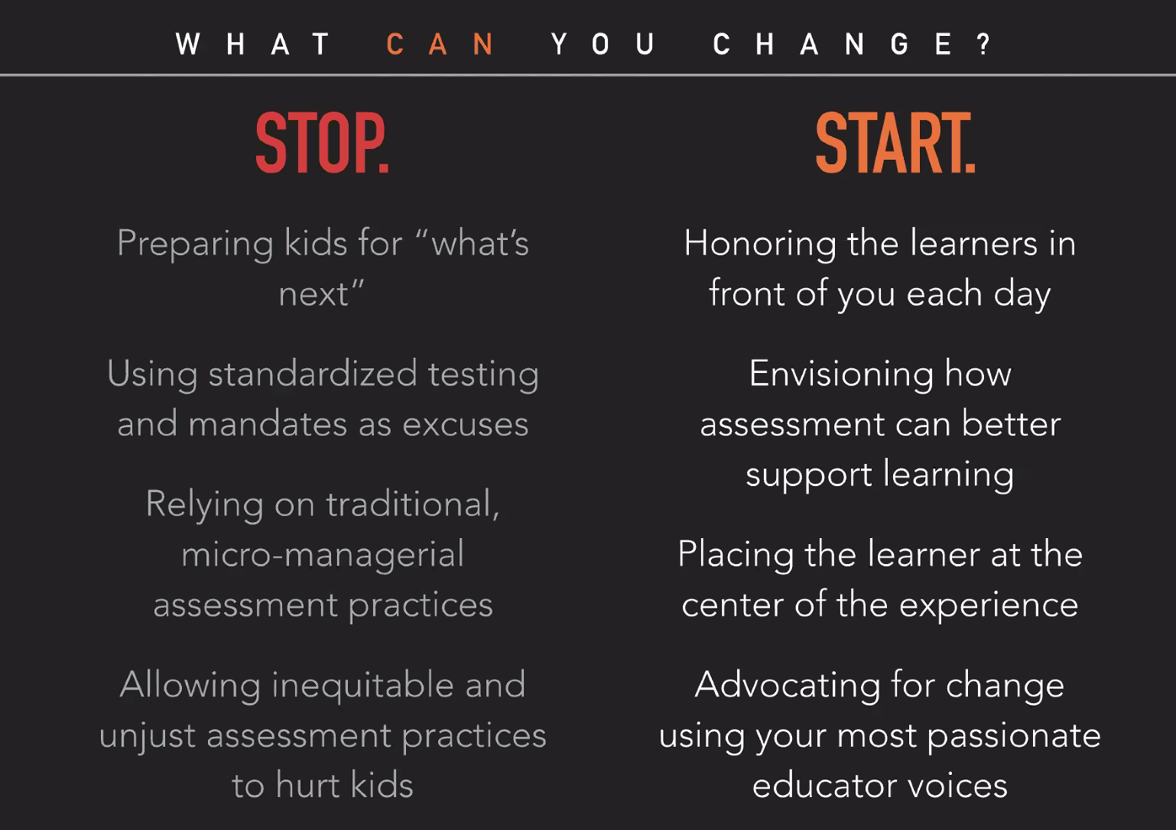

Slide 17

As a strategic plan team member, what were key concepts you found in the homework articles that we all need to keep in mind as we do our work together?
Generate 3-5 key concepts from the article you read.
Be ready to share with your team.
Homework Activity

Slide 18
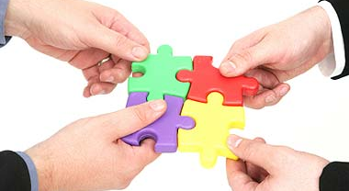
Steps in the Process

Slide 19
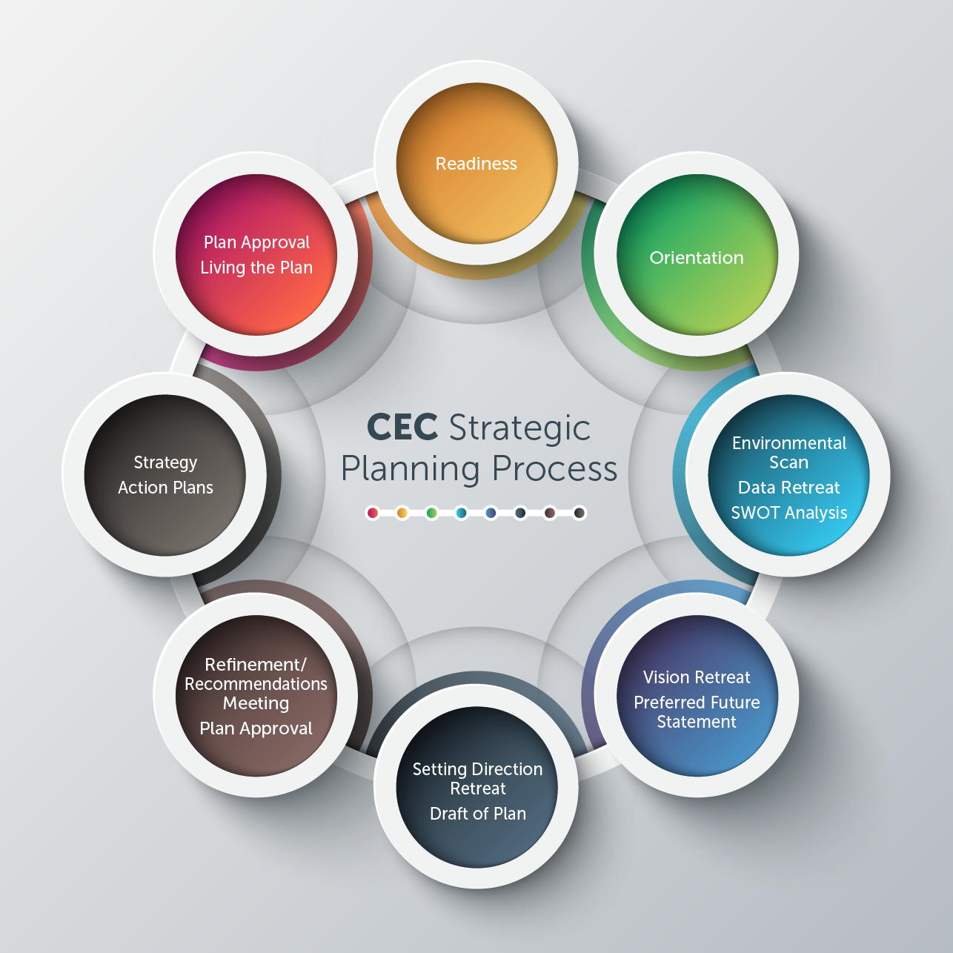

Strategic Plan
Mission
Vision
Core Values/Commitments
Long-Range Goals/Objectives
Indicators, Measures, Targets
Critical Strategy Action Plans

Slide 20
PART ONE: Determine the current state of the district – Where are we now?
STRENGTHS
WEAKNESSES
OPPORTUNITIES
THREATS
State of
District
Environmental
Scan
Data
Retreat
School/
Community
Feedback
Data Retreat

Slide 21

GOALS
QUALITY STAFF
RESOURCES
FINANCIAL
FACILITIES
TECHNOLOGY
FAMILY/
COMMUNITY
ENGAGEMENT
STUDENT
GROWTH &
ACHIEVEMENT
CULTURE:
LEARNING CONDITIONS
TEACHING CONDITIONS
LEADING CONDITIONS

Slide 22
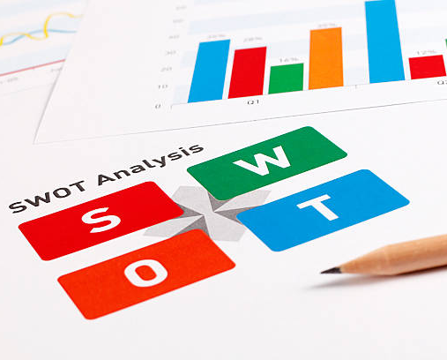
SWOT ANALYSIS
Strengths
Weaknesses
Opportunities
Threats

Slide 23
STRENGTHS
WEAKNESSES
What do we consider to be our weaknesses?
THREATS
Who or what threatens us the most?
OPPORTUNITIES
What opportunities for improvement do we know about but have not addressed?
What are we most criticized for or receive the most complaints about?
What do we seem to have a hard time doing well?
Where with a little work could we change a weakness into a strengths?
What challenges are coming that we must respond to?
What might block our progress?
What do we consider to be our strengths?
What advantages to do have?
What do others say our strengths are?

Slide 24
PART TWO: Determine the “PREFERRED FUTURE”- Where do we want to be?
Current
Strategic Plan
Mission and
Vision
Belief
Preferred
Future:
Mission,
Vision,
and
Values
Political, Social,
Economical,
Demographical,
Technological, &
Educational
Impacts
Vision
Retreat
School/
Community
Visioning
Forums
Vision Retreat

Slide 25
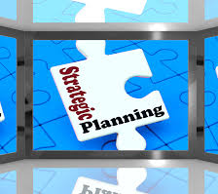
“Never doubt that a small group of thoughtful, committed citizens can change the world; indeed, it's the only thing that ever has.”
- Margaret Mead

Slide 26
MISSION
VISION
VALUES
GOALS
WHY:
Why do
we
exist?
WHAT?
What must our district
become to accomplish our purpose
HOW?
How must we behave to achieve our vision?
How will we mark our progress?
Fundamental
Purpose
Compelling
Future
Collective
Commitments
Targets
And
Timelines
Clarifies
priorities
and sharpens
focus
Sets
Direction
Guides
behaviors
Establishes
priorities

Slide 27

Shared
Mission
Vision
Values/Commitments

Slide 28
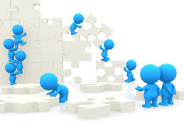
The words of mission and vision statements are not worth the paper they are written on unless people begin to do something differently.

Slide 29
The Process
SHAPE
MISSION
“true north”
Values
and
Commit-
ments
GUIDE
Vision
Goals
and
Strategies

Slide 30

How do we want to be different 5-10 years from now than we are today?

Slide 31
PART THREE: Draft the Plan - How do you get from where you are to where you want to be?
Data Retreat
Findings
Vision
Retreat
Findings
Draft
of the
Strategic
Plan
Setting
Direction
Retreat
School/
Community
Feedback
Setting Direction Retreat

Slide 32

“One is hard pressed to think of any organization that has sustained some measure of greatness in the absence of goals, values and missions that become deeply shared throughout the organization.”
~ Peter Senge
The Fifth Discipline
Notes:
32
Time: 2 minutes
Purpose: Establish the context for linking their work today with focus.
Lecture Notes: Senge, who first introduced us to the concept of a “learning organization” relating the importance of first building a solid foundation.
Activity Notes: Have them read the quote silently and check in with each other at their tables. “How do you define GREATNESS?”
Resources: Participant Manual, cover page in Focus Tab
Audience Reaction:

Slide 33
SMART goals require aligned strategies and well-designed action steps in order to provide stakeholders with a map of what’s important and a plan for how to get there.
District-wide SMART Goals, Indicators, Measures and Targets
District-wide Strategies
to Drive Improvement
District-wide Action Plans
To Drive Implementation
Monitoring, Adjusting, and Reporting

Slide 34
SMART Goals
Indicators and Measures
With clear TARGETS
PLAN
High-Yield Strategies
Intended to Positively
Impact SMART Goals
and TARGETS
DO
ACT
STUDY
Notes:
 ANIMATED SLIDE
FACILITATOR NOTES:
34

Slide 35

What do we need to do to close the gaps and get closer to realizing our mission, vision, values and goals?

Slide 36
PART FOUR: Finalizing the Plan
SWOT
Analysis
Preferred
Future: Mission,
Vision, &
Values
Draft of Plan:
Goals
Measures
Strategies
Board of
Education
Approval
School/
Community
Feedback
Plan
Team
Approval
Final Mtg.

Slide 37
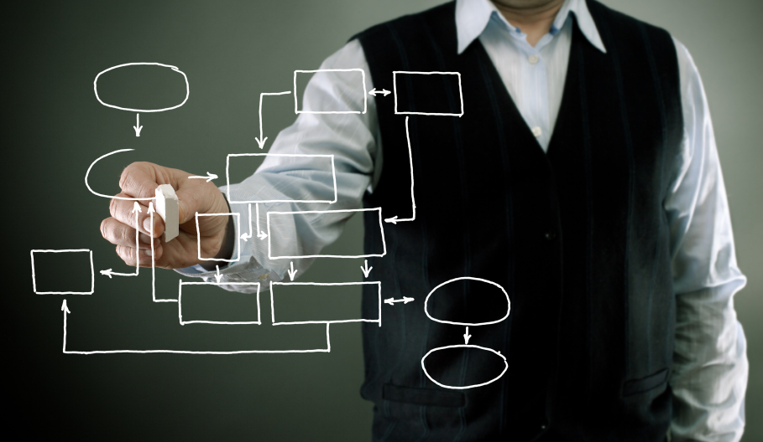
PLAN DRAFT

Slide 38
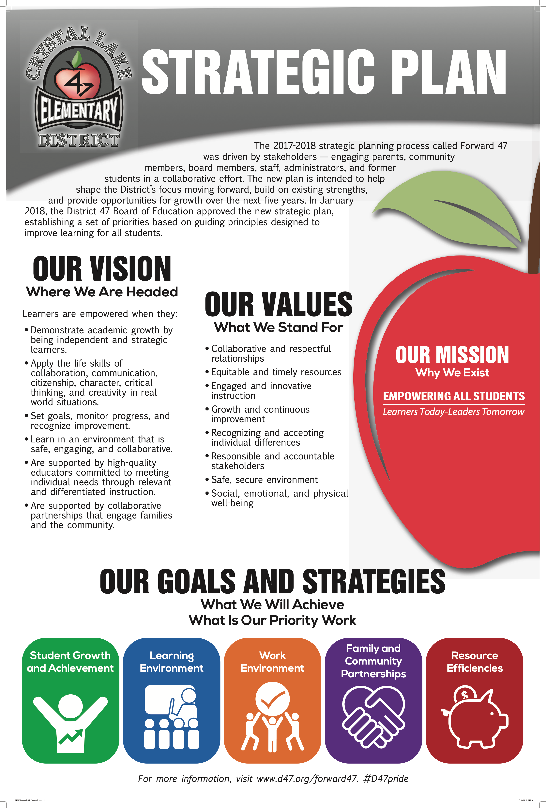
Deliverables
One Page Strategic Plan- Vision, Mission, Values/Beliefs, Goals, Strategies
Support Document containing details related to the One-Page Plan

Slide 39

FEEDBACK AND REFINEMENT

Slide 40
PART FIVE: Approval of Plan & Next Steps
Data Retreat
Findings
Visioning
Retreat
Findings
Scorecard
Goals
Measures
Timelines
Strategies
Board of
Education
Refinement
Approval
Writing
Team
Plan
Team
Revision
Approval

Slide 41
Align goals and strategies to a data system
Identify key indicators, measures, and targets for all goals and strategies
Align the data system to a progress monitoring and reporting system for all stakeholders.
Progress monitor and report growth and achievement while making adjustments to ensure improved results
Align the Plan to the work structures and shared decision-making processes
Align the plan to school, team, department and program structures and processes to ensure ownership, responsibility and accountability
Align the Plan to individual and team performance and program evaluation
Align individual, team, school, and program goals and feedback to the data system
Align the Plan strategies to PDSA action plans
Align budget and meeting agendas to the Plan to ensure focus and priority.
Align the Plan to resources of time and money
Make sure strategy actions plans follow a consistent SMART process to develop a two-way collaborative communication system

Slide 42


LIVING THE PLAN
STRATEGIC MANAGEMENT

Slide 43
Strategic Management Needs Assessment Survey
.

Slide 44

Two Basic Questions
Are we doing things RIGHT? OPERATIONAL MANAGEMENT
Are we doing the RIGHT things? STRATEGIC MANAGEMENT

Slide 45
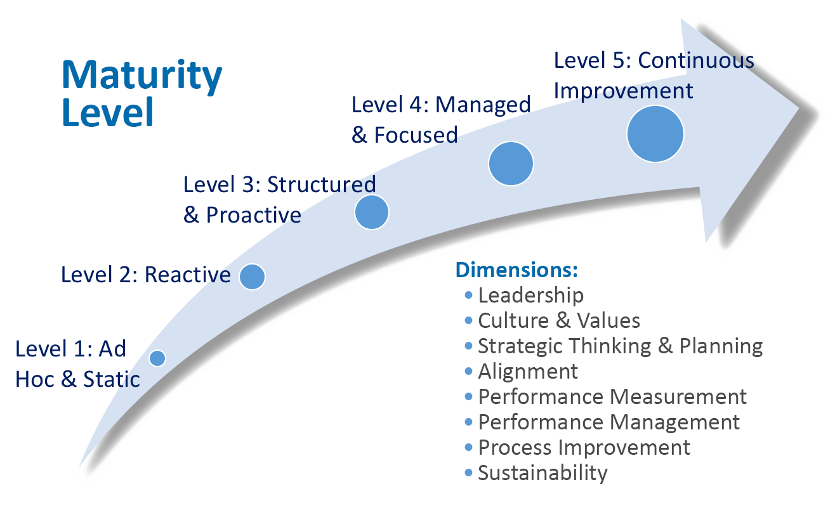
Strategic Management Maturity Assessment

Slide 47
Dimension: n = 33 | Total Points | Mean Score | Strength or Opportunity
Leadership | 127 | 3.85
Values and Culture | 97 | 2.94
Strategic Thinking and Planning | 83 | 2.52
Alignment | 74 | 2.24
Performance Measurement | 83 | 2.52
Performance Management | 113 | 3.45
Process Improvement | 85 | 2.56
Sustainability | 79 | 2.39

Slide 48
Assessment: Strategic Management Maturity Model n= 33
Dimension: | Level 1: Ad hoc and Static | Level 2: Reactive | Level 3: Structured & Proactive | Level 4: Managed and Focused | Level 5: Continuous Improvement
Leadership | Leaders dictate/command & control; otherwise disengaged | Leaders dictate but gather feedback sporadically | Leaders model desired behaviors and values but engage with direct reports only | Leaders empower many employees through ongoing engagement | Leaders & employees fully engage in a continuous dialog based on a team-based culture
Culture & Values | Vision and values undefined or not shared | Vision & Values published, but not lived | Vision & Values communicated and understood | Vision & Values collaboratively developed & reviewed | Vision & Values are fully integrated into the organization’s culture
Strategic Thinking & Planning | No strategic planning occurs within the organization; no goals defined | Strategic planning is the responsibility of a small team and dictated to the organization | A structured and open planning process involves people throughout the organization | Plans are developed and revised regularly by trained, cross-functional planning teams | Strategy drives critical organizational decisions and a continuous improvement planning process is maintained
Alignment | Work is narrowly focused based on organization structure, with little customer input | Customer needs and feedback start to influence more aligned decision-making | Employees know their students, families, and community, and align strategy to those needs | Vision, customer needs, strategy and employee reward and recognition systems are cascaded and aligned | All structures and systems are aligned with strategy, and organizational alignment is continuously improved
Performance Measurement | No data, or only ad hoc performance measures are collected | Performance data collected routinely, but are mostly operationally focused | Strategic performance measures are collected, covering most strategic goals and action plans | Strategic measures are broadly used to improve focus & performance and inform budget decisions | Measurements are comprehensively used and routinely revised based on continuous improvement
Performance Management | No emphasis on using performance as a criterion to manage the organization | Performance reviews required but not taken seriously; little accountability | Measures are assigned owners and performance is managed at the organization & employee levels | Measurement owners are held accountable and performance is managed at all levels | Organizational culture is measurement and accountability focused; decisions are evidence-based
Process Improvement | Processes are undocumented and ad hoc with evident duplication and delays | A few key processes documented, and process improvement models/frameworks introduced | All key processes are identified and documents and strategy guides successful process improvement | All key processes are tracked and improved on a continuous basis and new process improvement ideas are accepted | Employees are empowered and trained, and formal process exists for improving process management
Sustainability | Lack of structure and champions lead to short-term focus on tasks | Strategy “champions” identified 2 | Formal organization structure in place to maintain focus on strategy | Organization has an “Office of Strategy Management” or equivalent | Strategic thinking and management are embedded in the culture of the organization

Slide 49
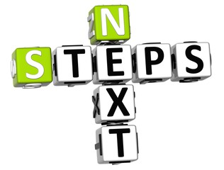
Analysis of Strategic Management System
Areas of Strength | Areas for Growth and Opportunity
Leadership | Strategic Planning and Thinking
Performance Management | Process Measurement
Values and Culture | Process Improvement
 | Sustainability
 | Alignment

Slide 50

Review of Current Plan
Hear about the Current Plan
It is a living plan?
Are there parts of it on which we can build a new plan?

Slide 51

Examine the Strategic Plan of another district. What makes this a SMART Plan?

Slide 52
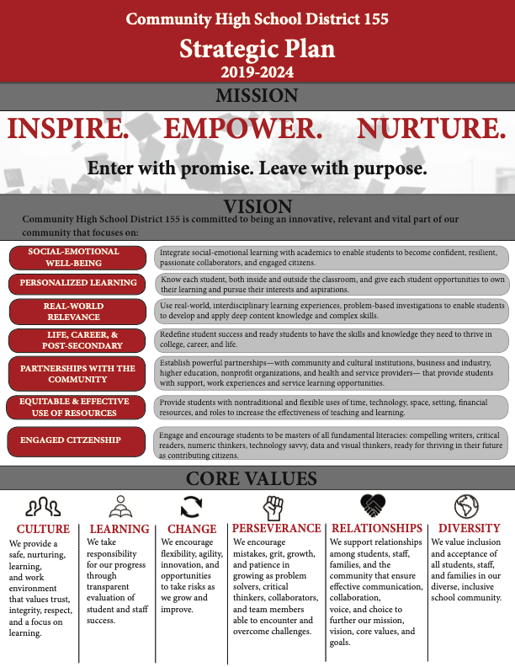
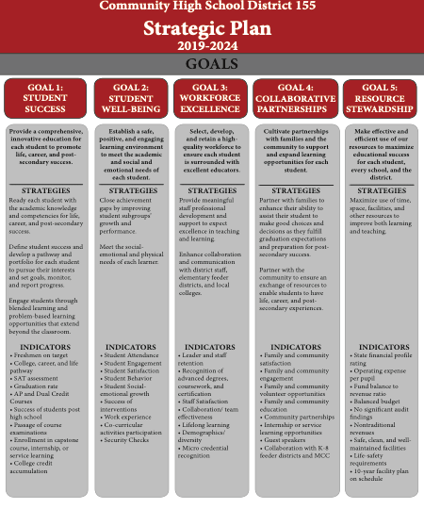

Slide 54
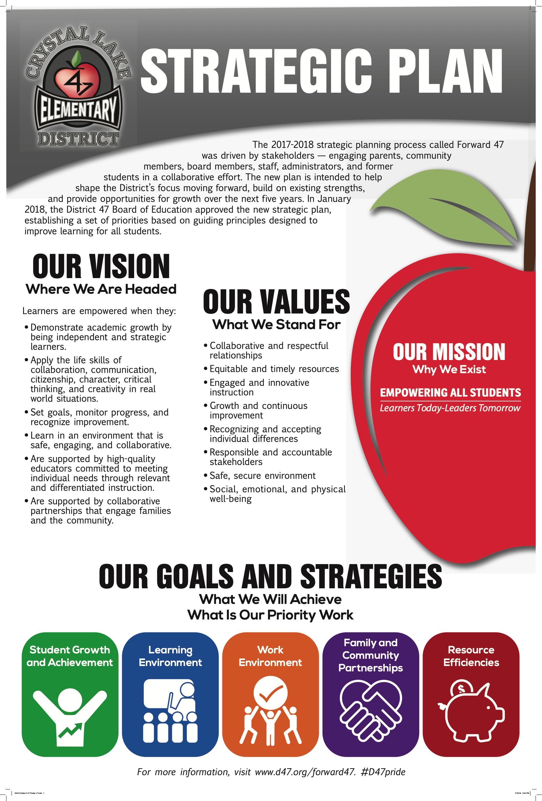
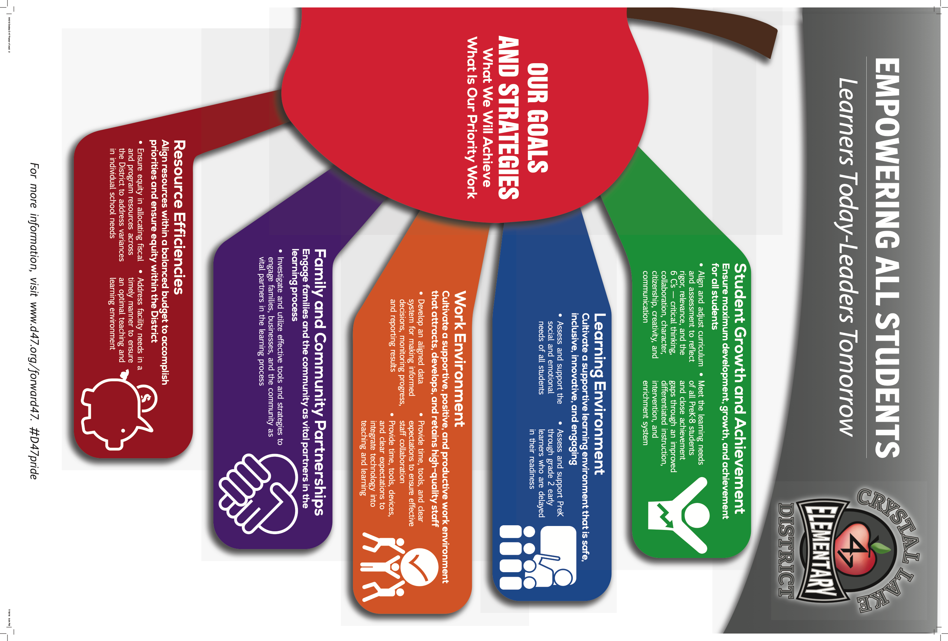

Slide 56
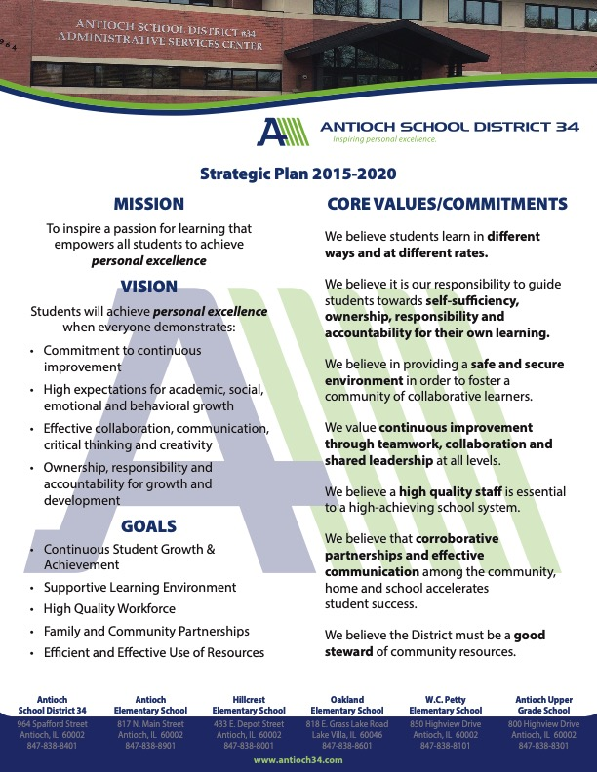

Slide 57

Strategic Plan Website
Demonstrate how our work will be documented and accessible throughout the process for team members and constituents.
Strategic Planning Website

Slide 58


Preview Data Retreat
Answers the question: Where are we now?
Paint a data picture to identify what is trending in a positive direction and what is trending in a negative direction
Know our strengths and celebrations
Know our weaknesses and opportunities
Prepare a SWOT analysis

